Slide 1
Two longitudinal studies of literacy in typical and struggling learners
How their findings can influence
assessment, teaching and intervention
Dr Valerie Muter
Consultant Clinical Neuropsychologist
Learnus, February 2022

Slide 2
Structure of the Presentation
The importance of reading.
I will present two longitudinal studies:
One of typically developing learners during their first two years at school,
The other of at-risk learners from ‘dyslexic’ families followed from pre-school to early adolescence.
Consider the impact of their findings on:
Our understanding of the processes involved in early reading development and how that can impact classroom teaching methods, early screening and identification and the need for integrating oral and written language,
How we explain the variation in expression of children with literacy difficulties and the impact that has on how we should assess, how we should teach and how we need to take account of (other) co-occurring learning difficulties.

Slide 3
Why Reading is so Important
One of mankind’s greatest achievements.
‘It is only through writing that almost all that is known today is known at all; science and history simply relies on too much information for it to be passed down through the generations by word of mouth alone’ (Altman, 1997).
Learning to read is arguably the single most important educational challenge facing primary school children.
However, substantial numbers of children find learning to read inordinately difficult; 1 in 6 children fail to read at a level that enables them to comfortably access their school curriculum.

Slide 4
Why the Early Stages of Reading are so Critical
Cunningham & Stanovich (1997) – ‘rapid acquisition of reading abilities ..help the development of the lifetime habit of reading’; based on a 10-year longitudinal study of typically developing readers.
Good start in Grade 1 led to children reading more and having improved understanding of what they read in Grade 11 than a slow start in Grade 1.
Conversely, a poor start in reading has a long-term detrimental effect –into middle childhood and well beyond even into adulthood (Maughan and Rutter long-term follow-up of original Isle of Wight sample into middle age).

Slide 5
Beginning to Read – The Predictor Approach
Hard to appreciate the underlying difficulties of the child with a literacy disorder without an understanding of the skills/processes needed for reading to progress normally.
This understanding stems largely from ‘predictor based’, research, both in typical and high-risk groups.
Predictors are skills/factors that contribute to literacy development, and which are definable, measurable and potentially modifiable through teaching.
Predictors may be cognitive (e.g. phonology, memory) or non-cognitive i.e. environmental (e.g. parent factors).
The first 2-3 years of learning are especially critical; foundation skills are established during this time and reading skills stabilise from age 8 onwards (with few changes in reading patterns or trajectories thereafter).

Slide 6
Developmental Progression of Phonological Skills

Slide 7
Beginning to Read- Which Phonological Skills are Most Important?
Bryant & Goswami (1990) Model
Rhyme Reading – direct route
Rhyme Phonemes Reading – indirect route
This model had a huge impact on teaching practices – with rhyming highlighted as the key phonological skill to be taught in the classroom especially in the 1990s.
Also strong emphasis on reading by analogy (word families) in contrast to traditional phonics e.g. sight, might, light’.

Slide 8
Beginning to Read Rhymes – or Phonemes?
Muter, Hulme, Snowling & Stevenson (2004).
90 children – recruited at age 4y and followed longitudinally to age 6y (3 assessment points).
Chartered development of language, phonology and reading during first two years at school.
Principal Components Analysis, PCA, showed that rhyming and phonemes are separate and indeed largely independent entities within the phonological domain.

Slide 9
Rhymes- or Phonemes?
Phoneme awareness is the better predictor of reading
Age 4/5
Age 6
Verbal IQ
Rhyming
Reading
Phonemes

Slide 10
Role of Letter Knowledge
Age 4/5 Age 6
Letter
Knowledge
Reading
Segmentation
Letter Knowledge
X
Segmentation

Slide 11
Beginning to Read - The Power of Phonemes and Letter Knowledge
Recent study by Snowling et al (2017) has shown that letter-sound knowledge, like phonological awareness, is predicted (and therefore driven) by early language (including vocabulary) skills.
Phoneme awareness, letter knowledge, and the interaction of phonemes and letters at ages 4-5y together account for nearly 90% of the variance in learning to read i.e. they explain nearly all the individual differences seen in children’s early reading development.

Slide 12
Implications for Teaching Practice From the Longitudinal Study of Typically Developing Readers
Simple phonological awareness and letter knowledge tests could be used as screeners to identify 5 year olds at risk of reading difficulties.
The role of rhyming in early progress in learning to read is overstated and the use of analogies for beginning readers overemphasised in teaching, at expense of phoneme/phonics instruction which has greater salience for early readers.
Vocabulary and early language drive progress in developing phonological and letter knowledge skills; therefore, important to ensure that children arriving at school with poor language skills receive additional oral language teaching.
Importance of emphasising systematic teaching of phonological awareness (especially in children arriving at school with limited skills in this domain) and also letter knowledge.
And most importantly, linking or ‘binding’ the two skills to critically
Establish the alphabetic principle, the foundation upon which all subsequent word level literacy skill develops.

Slide 13
Single Deficit Models (Frith 1996)
Level of Study
Dyslexia
genetic/brain
dysfunction
biological
level
cognitive
level
phonological
deficit
behavioural
level
reading
problems

Slide 14
Implications of the Single Deficit Model
Cognitive modules are separate and independent and underpinned in separate and independent brain modules.
Infers that you either have dyslexia or you don’t i.e. all-or-none; if you have a phonological deficit you have dyslexia, if you don’t have a phonological deficit you don’t have dyslexia.
Dyslexia is explained by the phonology-reading disconnection hypothesis – and nothing else.
If modules are separate and independent, co-occurrence with other learning disorders should be rare (< 1%).

Slide 15
An At-Risk Study of Dyslexia – that made us rethink the validity of the Single Deficit Model (Snowling et al ’94-’07)
Prospective study begun in 1992 of 74 children at genetic/family risk of dyslexia (+ 37 matched controls).
Children were assessed on a wide range of cognitive, language and educational measures at 3y9m, 6y, 8y and 12-13y.

Slide 16
At Risk Study – Phases 1 and 2 (3y9m-6y) Language and Phonological Deficits
Phase 1 (age 3y9m) at risk children scored below controls on wide range of language measures (receptive and expressive) - for many children, the deficits were subtle and most did not meet criteria for diagnosis of Developmental Language Disorder; but clear evidence that many dyslexic children exhibit early language difficulties and that these predate the onset of reading problems.
Phase 2 (age 6y), half the children in at risk group were delayed in reading relative to controls and scored well below controls on measures of phonological awareness and letter knowledge.

Slide 17
At-Risk Study – Phase 3 (8y) Continuity and Compensation
Authors predicted that at-risk children with phonological deficits would have reading difficulties – in keeping with the single deficit model. However……..
66% of at-risk children were experiencing significant ‘across the board’ literacy problems – ‘at risk impaired’.
34% of at-risk children classified as normal readers showed deficits in spelling, short-term verbal memory and phonological skills – ‘at risk unimpaired’.
Family risk is ‘continuous’ and dyslexia occurs along a continuum of severity – not ‘all or none’.
At-risk normal readers usually had good oral language skills – functioning as a compensatory/promotive or protective factor.
At-risk poor readers had accompanying oral language problems – goes against simple phonology-reading disconnection as sole explanation for dyslexia.

Slide 18
At-Risk Study – Phase 4 (12 years) Explaining Co-occurrence
In the long-term Family At-Risk study (Snowling et al, 2007), 70% of reading impaired children at age 12 had either attention, maths, language or visuomotor difficulties as well (and sometimes more than one of these).
But single deficit models have difficulty explaining such high rates of co-occurrence.
If modules are separate and independent, how can co-occurrence be so common?
A co-occurring difficulty may be a forerunner of dyslexia and pre-date it (e.g. with language disorder) or the 2 disorders may co-exist at the same time (e.g. with dyscalculia).

Slide 19
At Risk Study – Phase 4 Some Non-Cognitive Factors
At risk poor readers read far less than the at risk good readers and controls – this avoidant behaviour reduces print exposure
vicious circle that exacerbates reading problem and results in oral vocabulary decline (Matthew Effect).
At risk poor readers demonstrated to have self-esteem and anxiety issues.

Slide 20
Explaining Co-occurrence: Shared and Non-Shared ‘Risks’ Pennington, 2009
Genes and cognitive risks are shared across learning disorders – which is why they co-occur or overlap.
Genes do not cause learning disorders, but they create risks (increased probability) of the child developing the disorder.
A phonological deficit is a high risk factor in dyslexia but other cognitive risk factors may play a role in individual children e.g. weak short-term memory, slow auditory processing, delayed language (Snowling et al studies).
There are also non-shared risks which are specific to a given learning disorder – which explain the incomplete overlap.
These risks can be reduced by moderator variables, including the child’s learning environment (e.g. home support, intervention).

Slide 21
Practical Implications from the At Risk Study (1)
Dyslexia runs in families - check if other family members have literacy problems – warrant monitoring of progress.
Children with language delay are at risk of later literacy problems, especially if their language problems do not resolve by the time they start school - need close monitoring, early oral language intervention programmes in reception and Year 1 - and some may need speech and language therapy.
Assessment needs to address the multidimensional nature of literacy difficulties, to capture individual variations in expression – a single word reading test is not enough!
And following on from that, phonological and phonic interventions need to be integrated within a broad literacy curriculum that emphasises oral language and reading comprehension.
Reading skills change little after 8y - for maximum effectiveness, intervention needs to be delivered shortly after school entry.

Slide 22
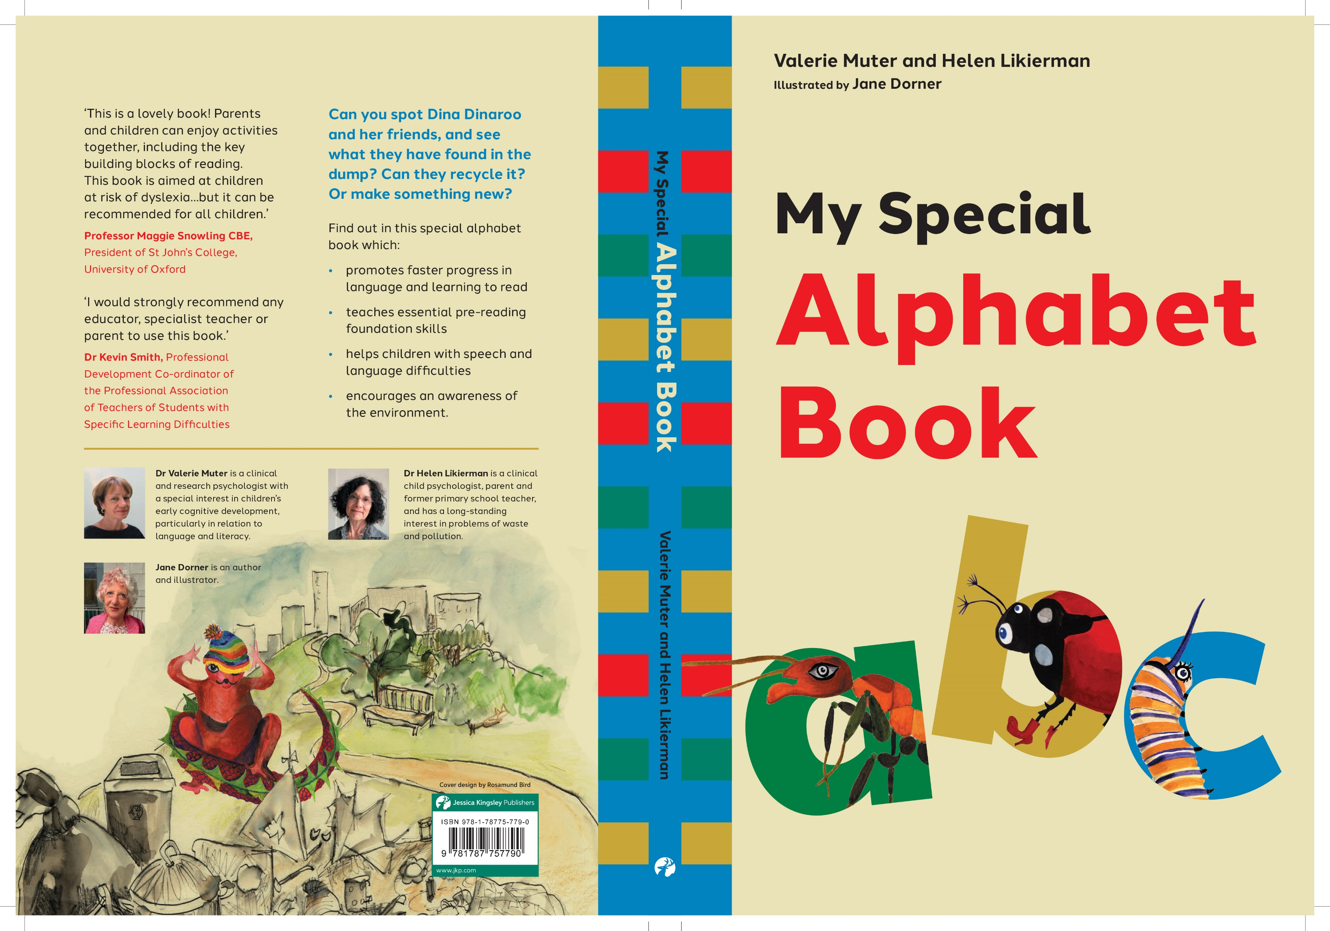

Slide 23
Practical Implications from the At Risk Study (2)
Poor readers must read - importance of increasing print exposure by building in opportunities and support for children to read on a regular basis - including incentive programmes.
Literacy difficulties persist into secondary school; these children need continuing support.
Providing emotional support to dyslexic teenagers to help them deal with self-esteem and anxiety issues.
Co-occurring difficulties may need to be addressed in their own right – assessing these and then providing interventions tailored to the difficulty through maths support, medication, physical therapies etc.

Slide 24
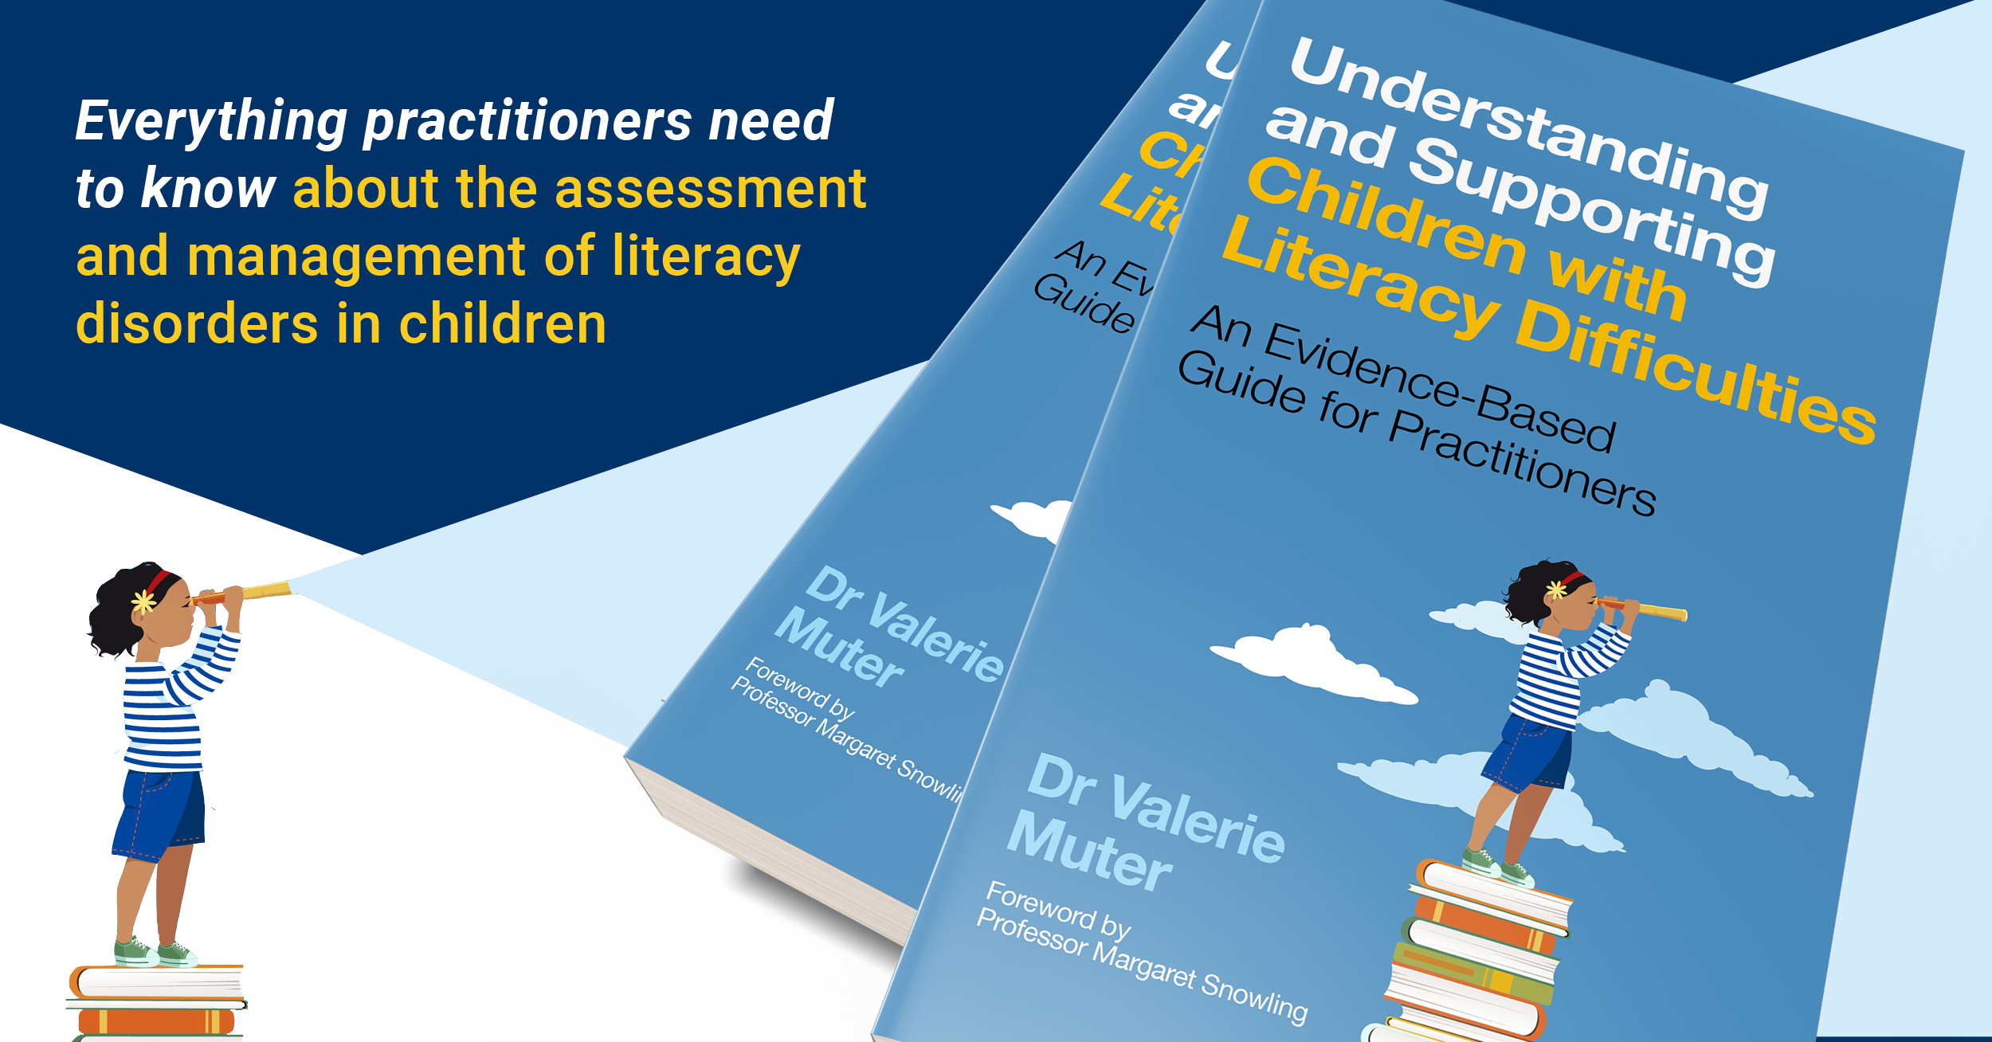
Good outcome
Dyslexia
Same predisposition but different outcomes
Poor outcome
Low parental support
Good parental support
Disengaged/low resilience
Motivated and resilient
Lack of quality intervention
High quality intervention
Moderator variables
Positive Negative
Late or no identification
Early identification
Co-occurring learning difficulties
No co-occurring learning difficulties
Impoverished learning environment
Stimulating learning environment
High verbal IQ/good language
mild
severe
Low verbal IQ/language difficulties
Phonological
deficit
Genetic/Neurodevelopmental
Predisposition

