Slide 1
Working Memory:
How it develops and classroom implications for educators
By Dr Rebecca Gordon
UCL Institute of Education
21/05/2025

Slide 2
About Dr Rebecca Gordon
Associate Professor in Cognitive Developmental Psychology
Department of Psychology and Human Development
Advocate for educational neuroscience in teacher training
Research focus:
  working memory
  how it’s measured
  what it tells us about the process of learning

Slide 3
Today’s takeaways:
Understand…:
…what working memory is
…its role in education
…how it develops

Slide 4
Today’s takeaways:
Understand…:
…what working memory is
…its role in education
…how it develops

Slide 5
The simplicity and complexity of working memory:
The temporary processing and storage of information in pursuit of a known goal.

Slide 6

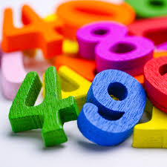

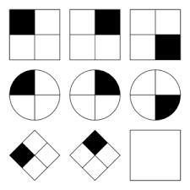
The simplicity and complexity of working memory:
What does this involve?
Processing information

Slide 7
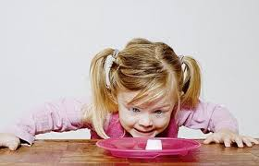

The simplicity and complexity of working memory:
What does this involve?
Inhibitory control/inhibition

Slide 8
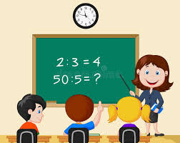


The simplicity and complexity of working memory:
What does this involve?
Attentional control/task-switching/cognitive flexibility

Slide 9
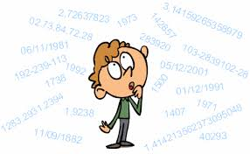
The simplicity and complexity of working memory:
What does this involve?
Verbal short-term storage and maintenance

Slide 10
The simplicity and complexity of working memory:
What does this involve?
Visuospatial short-term storage and maintenance

Slide 11
The simplicity and complexity of working memory:
Executive function
  Inhibitory control/inhibition
  Attentional control/switching/flexibility
  Updating verbal and visuospatial information and maintaining it for short periods
  In novel situations (i.e. not automatised behaviours)
  In pursuit of a known goal

Slide 12
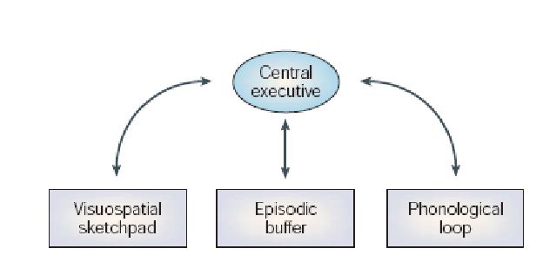
The simplicity and complexity of working memory:
Different theories and models
Baddeley and Hitch (1974) model
Central executive:
  Switching
  Inhibitory and interference control
Short term verbal and visuospatial stores
Episodic buffer

Slide 13
The simplicity and complexity of working memory:
Why am I telling you this?
  Disambiguation
  WM isn’t one thing
  Variability in terminology in research literature
  …and in DfE literature
    Executive function referred to in Development Matters curriculum guidance (DfE, 2023)
    Working memory referred to in the Early Career Framework (DfE, 2024)

Slide 14
The simplicity and complexity of working memory:
A set of abilities and skills that facilitate the concurrent processing, manipulation and maintenance of information for short periods of time in the pursuit of a known goal.

Slide 15
Today’s takeaways:
Understand…:
…what working memory is
…its role in education
…how it develops

Slide 16
Working memory and education
Very strong link between performance on WM tasks and:
  educational outcomes generally
  Numeracy
  Literacy
Impaired WM is related to poorer academic outcomes

Slide 17
Why does it matter in the classroom
WM required to:
  remember classroom instructions
  storing and processing information
  keeping track of progress in difficult tasks
Cumulative effect
  Impaired ability to learn earlier information jeopardizes subsequent learning

Slide 18
Isn’t it just intelligence?
Is WM a proxy for IQ or a unique ability for learning?
A lot of evidence that it isn’t…in childhood
Longitudinal study by Alloway and Alloway (2010)
  Measured WM and IQ at 5 years and then 6 years later (at 11 years)
  WM at 5 yrs was best predictor of literacy and numeracy at 11 yrs
  IQ was a much weaker predictor
Alloway and Alloway (2010)

Slide 19
Working memory and IQ
Mother’s education linked to child’s literacy skills and IQ (Time 2)
  Unsurprising: home environment has strong influence on education
  How much the caregiver talks to the child
  Attitudes toward education etc.
But…WM was impervious to SES factors from 5 to 11 years
Alloway and Alloway, (2010)

Slide 20
Working memory and IQ
WM is a relatively pure measure a child’s capacity to learn
Children in bottom 10% likely to remain there throughout school
Weak evidence for effectiveness of WM training programmes
Sounds grim, but is it really immutable?

Slide 21
Today’s takeaways:
Understand…:
…what working memory is
…its role in education
…how it develops

Slide 22
Working memory development
Inhibition and inhibitory control:
Starts forming early: improvement from infancy to toddlerhood
Ability to inhibit an inappropriate response increases greatly between 7 to 9 years
Interference control increases gradually through to adolescence
Attentional control/cognitive flexibility:
Most noticeable changes between 5 and 8 years
Then subtler changes from 11 to 16 years

Slide 23
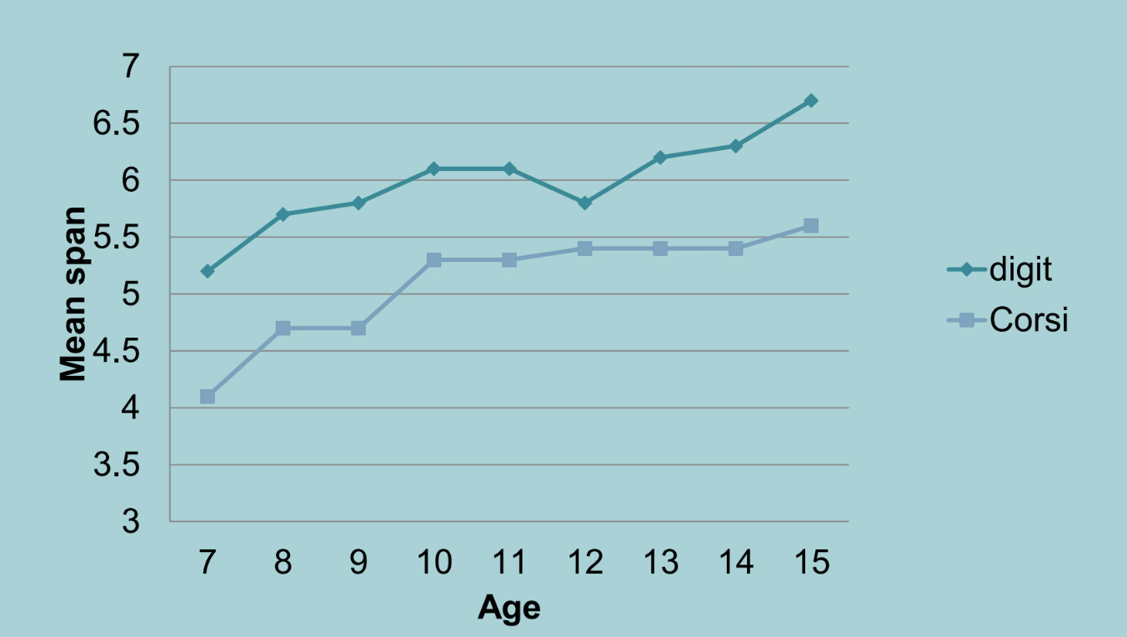
Working memory development
Short-term memory (Isaacs & Vargha-Khadem)
Verbal: Increases to ~15 years
Visuospatial: Plateaus at ~12 years
Speed of information processing:
Clear increases up to 12 years
Largest increase between 9 and 12 years
Stabilises to adult levels at ~15 years
Highly heritable and strong predictor of later WM

Slide 24
Environmental influence on WM development
Neurodevelopmental disorders (e.g. dyslexia, ADHD, autism, DCD, DLD)
Nutrition and hydration
Home environment (nurturing or hostile)
Anxiety
Outdoor space (spatial reasoning and motor development)
Puberty (more later)
Education environment

Slide 25

Environmental influence on WM development
Neurodevelopmental disorders (e.g. dyslexia, ADHD, autism, DCD, DLD)
Nutrition and hydration
Home environment (nurturing or hostile)
Anxiety
Outdoor space (spatial reasoning and motor development)
Puberty (more later)
Education environment

Slide 26
Does environment matter?
Study by Louise Livingstone
127 children tested at 3 years, 4 years and 4.5 years
Group comparisons between Montessori and mainstream schools
Homogeneity in terms of household income and child’s sex
Measures
Working memory
Manual dexterity (posting coins, threading beads and drawing trails)
Gross motor skills (aiming and catching; balancing and jumping)
Numeracy
Early reading skills and alphabet writing fluency

Slide 27
Does environment matter?
Why Montessori? Why motor skills?
Fosters the systematic development of life skills
…which includes a substantial focus on various fine and gross motor skills (e.g. tying shoe laces)
Fits well with the interactive model of executive function…
…and the evolutionary understanding of the development of complex motor and higher-order cognition
…and with the Piaget theory of child development
Humans (and some primates and bords) evolved to move…
…and then to think about and plan movement in order to…
“act independently in our own best interest, at any point in time, for the purpose of survival”
(Koziol, 2012; Miller, 2007; Livingstone, 2025)

Slide 28
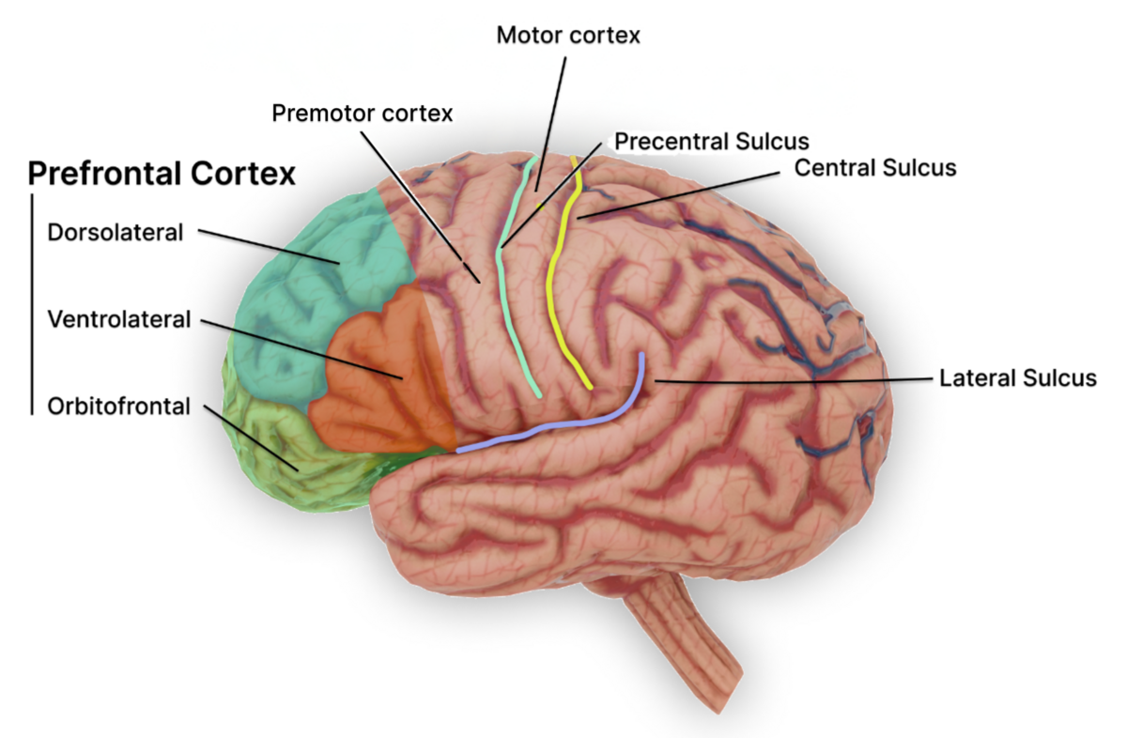
Motor and executive abilities
Motor cortex: execution and control of movements
Premotor cortex: planning and preparing movements
Prefrontal cortex: Higher-order cognitive functions
working memory
Executive functions
Decision-making
Planning
Attention
Social behaviour
Emotional regulation

Slide 29
Does environment matter?
T1: 3 years
T2: 4 years
T3: 4.5 years
Numeracy:
For both Montessori and mainstream children:
  Bidirectional longitudinal relationship between fine motors skills and WM
  Unidirectional relationship between gross motor skills and WM
WM at T1 and T3 predicted numeracy at T3 for both groups
Montessori group performed better on WM measures at T2 and T3
Montessori group performed better on gross motor skills at T2
Montessori group performed better on numeracy at T3
Fine motor skills and WM measured at T2 interacted to predict numeracy at T3 only for the Montessori group
Literacy:
Fine motor skills and WM interacted to predict literacy at T3 for both groups
Gross motor skills and WM interacted to predict reading skills at T3 in the Montessori group

Slide 30
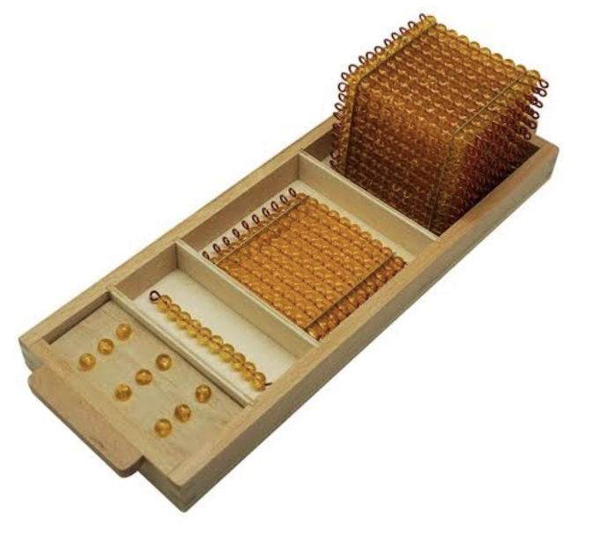
Does environment matter?
Improved motor skills >
improved WM >
improved educational outcomes
How can we use this to help children:
Design classroom activities that combine motor skills and WM:
  e.g. pattern making with beads into mathematical tasks
Use concrete representations:
  Children can hold information in hand and mind while they work out the next required action
  e.g. manipulate counters to teach counting
Montessori Decimal Beads
Represent different quantities (1, 10, 100, and 1000)
Allows child to physically manipulate them
Aids is grasping concepts like addition, subtraction, and place value

Slide 31

Outside the classroom: The ecology of WM
In unstructured environments:
Children have more latitude to seek solutions, be creative, use selective attention
People can perform poorly at school but be highly intelligent and flourish in other environments.
Don’t throw away the classroom, but…
Cognitive abilities that might seem innate are actually influenced by environment
e.g. processing speed, might be innate, but…
… inhibition, attentional switching can be affected by environmental factors

Slide 32
Working memory and adolescence
In typical development
Inhibitory control (9 years – though interference control continues through adolescence)
Attentional control (~16 years)
Verbal and visuospatial short-term memory (~15 and 12 years respectively)
Processing speed (~15 years)
…are quite well-established by adolescence
So why do we get this…

Slide 33

Working memory development
“The dozy teenager”

Slide 34
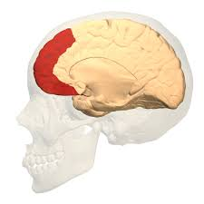
Working memory development
“The dozy teenager”

Slide 35
Working memory, adolescence and environment
So why aren’t teenagers performing at adult levels?
Protracted developmental trajectory of the pre-frontal cortex
Puberty: Important period of reorganisation
  Synaptic pruning and myelination
Teens explore and adapt to their changing inner and outer worlds
Produces opportunity and threats from the environment

Slide 36
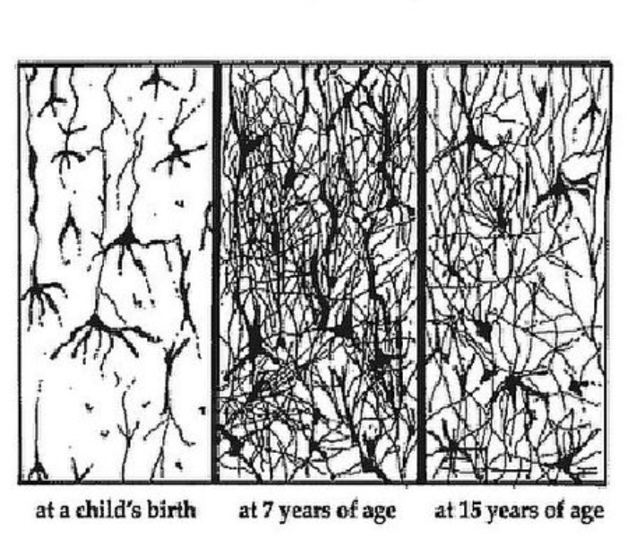
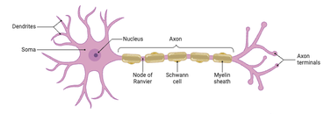
Cortical re-organisation
Synaptic pruning
Myelination

Slide 37
Cortical re-organisation
Synaptic pruning improves efficiency
Myelin enables coordinated and quicker communication between neurons
Temporarily reduces functionality
  A bit like turning off the electricity or plumbing during building works

Slide 38
Working memory, adolescence and environment
This sensitive period can
High sensitivity to reward – risky behaviours (good and bad)
Heightened emotional sensitivity - anxiety
Social environment – negative, positive
Health (nutrition, sleep, exercise, drugs)
Growing independence (all of the above)

Slide 39
Working memory, adolescence and environment
Different influential environments
Home
School
Peer groups
Culture, society and religion
Politics

Slide 40
Working memory: A summary
Be aware of how WM develops within environments
If an intelligent child is told to “apply themselves”…
  …are they unwilling or unable?
You will already know, but:
  Children have a natural tendency to learn
  It’s rare that they are just being “lazy” or “naughty”
  More likely they are finding it difficult to focus attention or filter out distracting stimuli…
  …due to any number of environmental factors…
  …leading to affective and cognitive consequences

Slide 41
Working memory: Some tips
Identifying children with WM deficits:
Normal social relationships with peers but…
…Reserved in group activities
Poor academic progress in reading and maths
Difficulties in following instructions
Problems with learning activities that require both storage and processing
Place-keeping difficulties
Appears to be inattentive and distractible
(Gathercole, 2008)

Slide 42
Working memory: Some tips
Helping children with WM deficits
Be clear about the purpose of a task – remove unnecessary complexity
Create routines to maximise automaticity (frees up WM)
Use prior knowledge (e.g. planet sizes using egg, orange, ball etc.)
Remove unnecessary processing (put the key question first)
Avoid splitting activities in time or space
(e.g. instructions given in one area and completed elsewhere)
Support memory: repetition, external memory aids, note taking
Maximise use of long-term memory (see knowledge base)
(Waterman & Miller, 2022)
Notes:
“The goalkeeper was on the six-yard line. The left back was on the goal line. The striker was on the penalty spot when the ball was played through. Was he offside?” This is easier to process if the key question is placed at the beginning: “I want you to work out if the striker was offside. The goalkeeper was on the six-yard line. The left back was on the goal line. The striker was on the penalty spot when the ball was played through. Was he offside?”

Slide 43
Working memory: Framing questions
“The goalkeeper was on the six-yard line. The left back was on the goal line. The striker was on the penalty spot when the ball was played through. Was he offside?”
“I want you to work out if the striker was offside. The goalkeeper was on the six-yard line. The left back was on the goal line. The striker was on the penalty spot when the ball was played through. Was he offside?”
(Waterman & Miller, 2022)

Slide 44
Thank you for your time
Any questions?
Notes:
“The goalkeeper was on the six-yard line. The left back was on the goal line. The striker was on the penalty spot when the ball was played through. Was he offside?” This is easier to process if the key question is placed at the beginning: “I want you to work out if the striker was offside. The goalkeeper was on the six-yard line. The left back was on the goal line. The striker was on the penalty spot when the ball was played through. Was he offside?”

