Slide 1
Neurodiversity Acceptance and Affirmation in the Classroom
Sue Fletcher-Watson
Learnus Annual Lecture, November 2022
sue.fletcher-watson@ed.ac.uk
@SueReviews
@SMRCResearch
https://medium.com/@suefletcherwatson/conflicts-of-interest-47a89a0c8e52
Notes:
In this seminar Sue will examine the role of neurodiversity as a guiding paradigm for neurodevelopmental research, with particular reference to autism. She will consider whether existing explanatory paradigms for autism and other neurodevelopmental diagnoses are adequate, and whether neurodiversity offers a better way. She will share neurodiversity-informed findings from her own research including work which is focused on evidence-based impact in education settings.

Slide 2
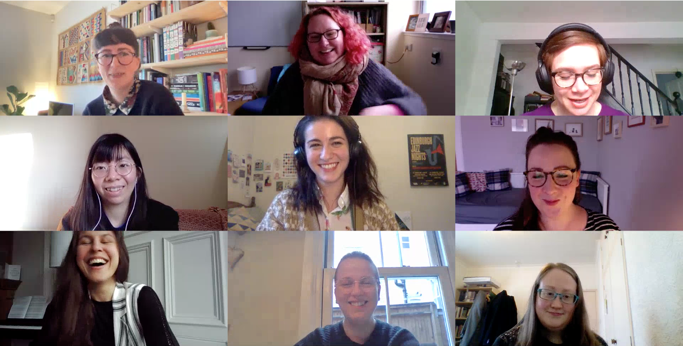
Autistic mentors & APOs: Kabie Brook, Fergus Murray, Autism Rights Group Highland, Autistic Mutual Aid Society Edinburgh, Participatory Autism Research Collective, University of Glasgow Neurodiversity Network.
Diversity in Social Intelligence: Catherine Crompton, Sonny Hallett, Emma Flynn, Dani Ropar, Noah Sasson, Claire Evans-Williams, Harriet Axbey.
LEANS: Alyssa Alcorn, Dinah Aitken, Sarah McGeown, Will Mandy, Fergus Murray, Liam Peacock
Neurodiversity Alliance: Francesca Fotheringham, Catherine Crompton, Katie Cebula, Karen Goodall, Sonny Hallett, Harriet Axbey

Slide 3
AN INTERNATIONAL NEURODIVERSITY CONFERENCE
13 - 14 March 2023 | EICC and online

Slide 4
Outline
The status quo
A neurodiversity-affirmative school
What is it?
The neurodiversity paradigm
Neurodiversity
Addressing common myths
School inclusion
Applying the paradigm in practice
Core Deficit theories
AN INTERNATIONAL NEURODIVERSITY CONFERENCE
13 - 14 March 2023 | EICC and online

Slide 5
What are core deficit theories?
Differential diagnosis
Core Deficit / Clinical Features
Targeted intervention
Normalisation outcome
Boiling diversity and complexity within and between diagnostic categories down to single “explanatory” roots
Core
Everyone in a diagnostic category is similar in some (simple, fundamental) way
Deficit
Diagnostic categories represent aberrance from the ideal
Examples
Theory of Mind and autism
Executive dysfunction and ADHD
Magnocellular theory and dyslexia
These drive intervention
Identify and treat
Downstream impacts

Slide 6
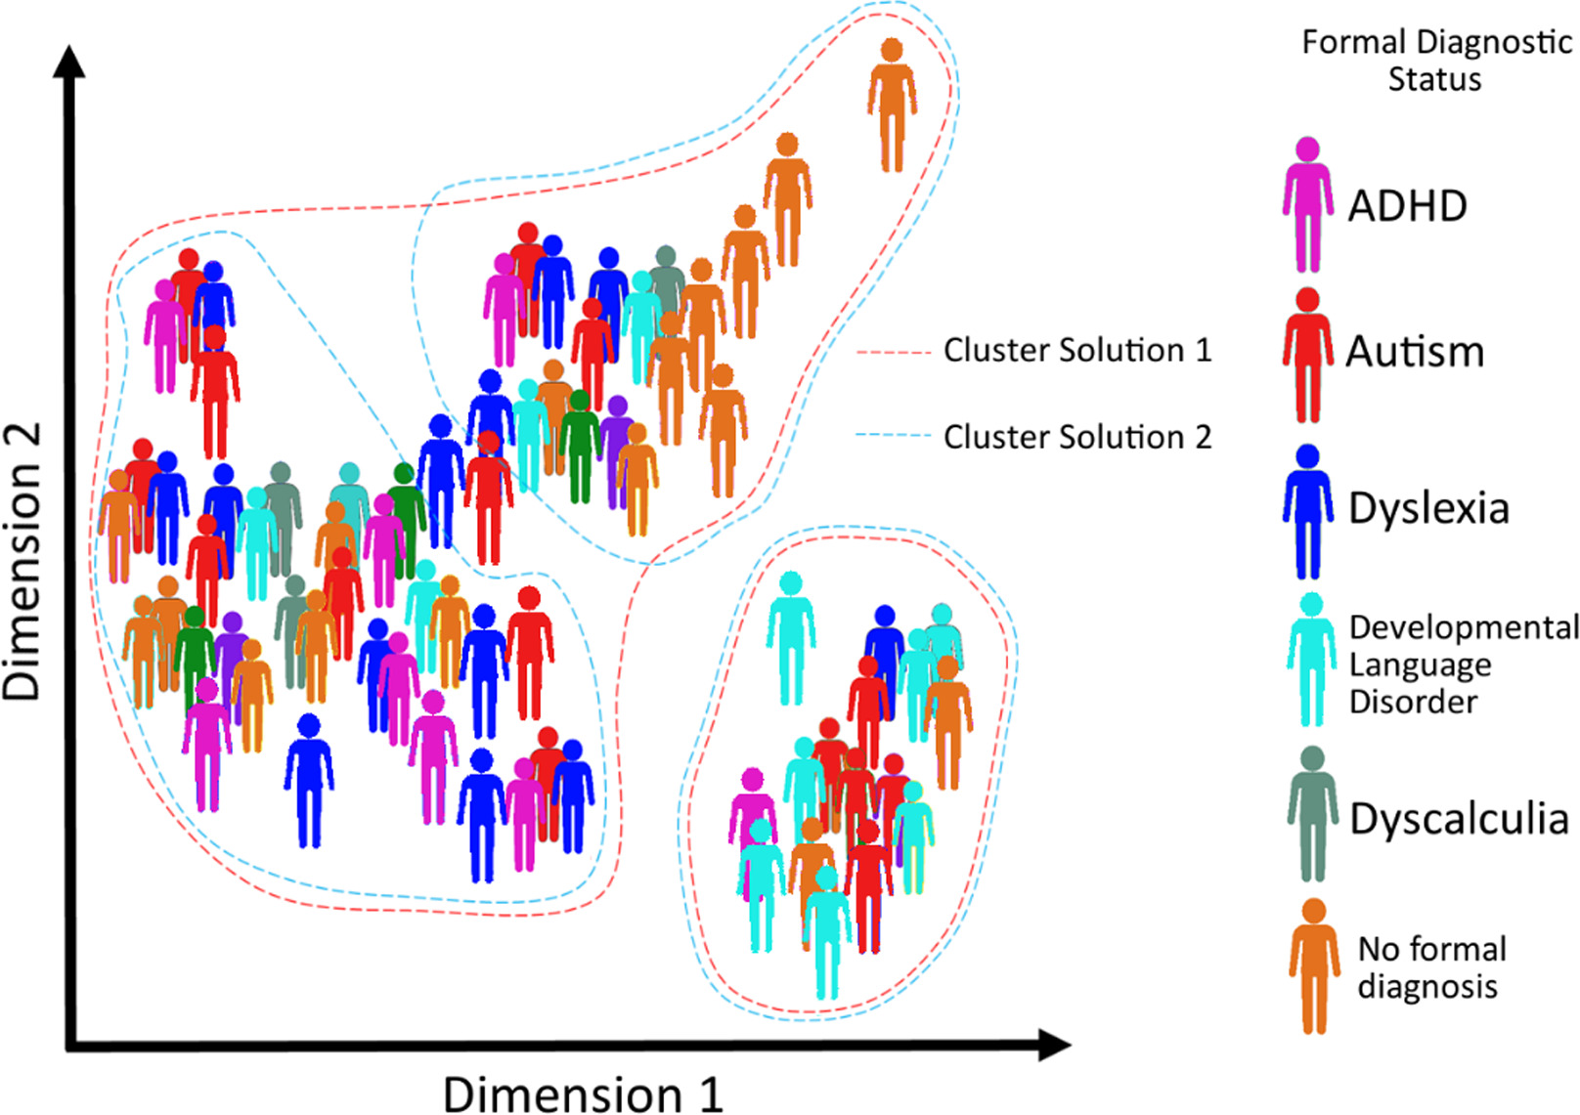
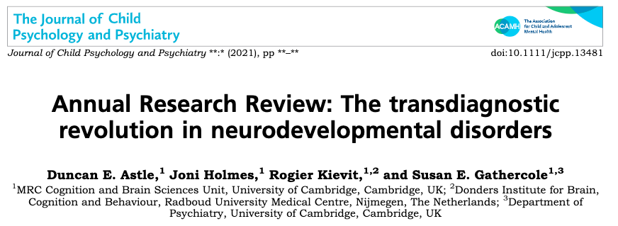
Show me the data: challenging the “core” assumption
One can group children by
cognitive profile
neural profile
genetic profile
diagnostic label
These groupings do not map onto one another
They do not necessarily predict learning outcomes either

Slide 7
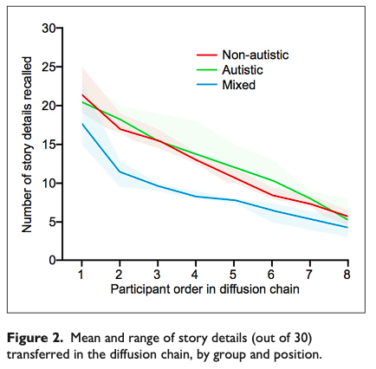
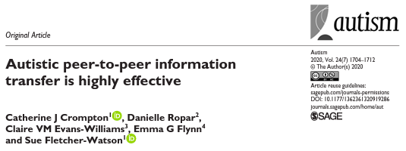
Show me the data: challenging the “deficit” assumption
Autism is defined clinically by social and communication deficits
So why do these “deficits” disappear during autistic-autistic interactions?
Diffusion chain results
Qualitative reports
Similar discussions for multiple diagnostic groups
Questioning labels
Greater focus on context and cultural variation
Role of the environment, other people
Damian Milton
Kilee DeBrabander, Desi Jones, Kerrianne Morrison, Noah Sasson
Hidetsugu Komeda, Morton Ann Gernsbacher
Lizzie Sheppard, Dani Ropar
Yu-Lun Chen, Kristie Patten

Slide 8
Setting the scene: UK schools
Great stuff
Tough stuff
Inclusion as standard
Specialist environments available
Dedicated staff
11th in world rankings
99% enrolment rate
Culturally valued
Under-resourcing
Curriculum pressure
Systemic inequalities
Poor neurodivergent outcomes
Exclusion, participation
Mental ill-health / low wellbeing
Bullying, victimisation

Slide 9
What about clinical support?
Scarlett is clearly bright but fidgets and has trouble concentrating in class
Refer Scarlett for diagnosis
One week
Teacher gives Scarlett a fidget toy, wobble cushion and movement breaks
Scarlett on the CAMHS waiting list for 18 months
Scarlett assessed for ADHD
Three years
Scarlett not diagnosed, another 12 months for second opinion
Scarlett ADHD diagnosis confirmed
Scarlett gets help at school

Slide 10
Outline
The status quo
A neurodiversity-affirmative school
What is it?
The neurodiversity paradigm
Neurodiversity
Addressing common myths
School inclusion
Applying the paradigm in practice
Core Deficit theories
AN INTERNATIONAL NEURODIVERSITY CONFERENCE
13 - 14 March 2023 | EICC and online

Slide 11
Neurodiversity: a paradigm shift
Neurodiversity is the fact that all human beings vary in the way our brains work.
take in information in different ways
process it in different ways
thus behave in different ways
The Neurodiversity Paradigm
Neurodiversity is naturally occurring
No one way of being is better than another
Neurodiversity operates like other equality & diversity dimensions
Strength in diversity itself – collective not individual value

Slide 12
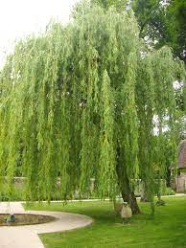
Using Nature to Understand Neurodiversity
Naturally occurring variation
Equal value
outcome dictated by environment-need match
Majority and minority / divergent status
individual and group-level differences (ND / NT)
Strength in diversity
a rich and varied biome
orchards are capitalist!

Slide 13
Common misunderstandings I
Neurodiversity is a synonym for SEND (or ASN, or ASL)
Risk of changing the language but not actions
Neurodiversity requires a rethink of how and why things are done in school
Risk of reinforcing stigma by failing to deliver on inclusive potential, cf “special needs”
“ND is not a classificatory term dividing us from them. We are all Neurodiverse. We live on a Neurodiverse planet in which amoral nature generates endless genetic diversity, while we humans have evolved the capacity to make judgments about nature’s bounty. What Neurodiversity brings us is a challenge to find a place for everyone and to distribute the bounty fairly.”
Singer: Neurodiversity: its politics, not science!
February 2021, Neurodiversity2.blogspot.com

Slide 14
Common misunderstandings II
Neurodiversity focuses only on the strengths and talents of individuals
Risk of putting additional pressure on ND students to excel in something
Neurodiversity reminds us that diversity itself is a strength
Risk of dividing ND into more / less valuable and failing the radical impact of the idea
Risk of reinforcing capitalist value system: measure people by their grades, and then earning power
“Discussing autism, ADHD, and dyslexia, [this article] claims the term neurodiversity was created to “shift the focus from the negative connotation of these conditions toward the positive,” a statement that waters the entire concept down into a floppy milquetoast version of its former self. It’s not a nice euphemism for autism, and it’s about far more than just fighting negative connotations.”
Meadows: You’re using the word ”neurodiversity” wrong.
August 2021, medium.com

Slide 15
Common misunderstandings III
Neurodiversity paradigm rejects the concept of disability
Risk of failing to be inclusive and beneficial to everyone – esp. people who identify as disabled and / or having a mental illness
Neurodiversity paradigm embraces the concept of disability and offers support without judgement or normalisation
Risk of equating “value” with “low support needs”, so “everyone has equal value” → no-one gets any support
”we should … not jump to rejecting the very possibility of mental pathology, or of a "wrong" brain ... Rather, we must work on allowing more space for individuals and groups to self-define as healthy or ill, different or disordered, perfect or broken, in need of either medical or political intervention, or whatever combination of these.”
Chapman: Negotiating the Neurodiversity Concept: Towards epistemic justice in conceptualising health. August 2021, Neurodiverse Age

Slide 16
Outline
The status quo
A neurodiversity-affirmative school
What is it?
The neurodiversity paradigm
Neurodiversity
Addressing common myths
School inclusion
Applying the paradigm in practice
Core Deficit theories
AN INTERNATIONAL NEURODIVERSITY CONFERENCE
13 - 14 March 2023 | EICC and online

Slide 17
A neurodiversity-affirmative classroom
expects heterogeneity
respects and makes use of pupil expertise
fights stigma
rejects normalisation
1. Neurodiversity is naturally occurring
4. Strength in diversity
2. No one way of being is better than another
3. Neurodiversity operates like other E&D dimensions

Slide 18
Expect heterogeneity
Reject Normalisation
A note on attendance goals
Vigilant to stereotypes based on gender or ethnic norms
Consider co-occurrence
Make resources freely available
Separate diagnosis from goals
Facilitate rather than correct
Set outcomes based on flourishing
Fight stigma
Make use of client expertise
Create an environment where ND people can be “out”
Actively cultivate pupil self-knowledge
Facilitate access to community
Use your expertise politically as well as in education
Work with parents, siblings and communities
Challenge assumptions

Slide 19
Outline
The status quo
A neurodiversity-affirmative school
What is it?
The neurodiversity paradigm
Neurodiversity
Addressing common myths
School inclusion
Applying the paradigm in practice
Core Deficit theories
AN INTERNATIONAL NEURODIVERSITY CONFERENCE
13 - 14 March 2023 | EICC and online

Slide 20
The Neurodiversity Alliance
Lots of evidence of preference to be with other autistic people
Peer support models
Interviews suggest need to include other ND people
a positive outlook on neurodivergent identity
sense of belonging
shared self-advocacy and academic skills
New model created
Co-designed
Inspired by existing LGTBQ+ provision
Mixed-methods evaluation in three schools
Francesca Fotheringham
@NeuroAlli_UoE
ND Peer Support
Principles of neurodiversity
Benefits for the community
Flexibility: format & focus
sue.fletcher-watson@ed.ac.uk
@SueReviews
@SMRCResearch
The co-design remit

Slide 21
The Neurodiversity Alliance
A neurodiversity-affirmative classroom
expects heterogeneity
respects and makes use of pupil expertise
fights stigma
rejects normalisation
Includes everyone, regardless of diagnosis, including allies
Francesca Fotheringham
@NeuroAlli_UoE
Co-designed.
Uplifts pupil expertise; role for campaigns and leadership
shares knowledge, creates a sense of belonging
sue.fletcher-watson@ed.ac.uk
@SueReviews
@SMRCResearch
brings people together, fosters pride

Slide 22
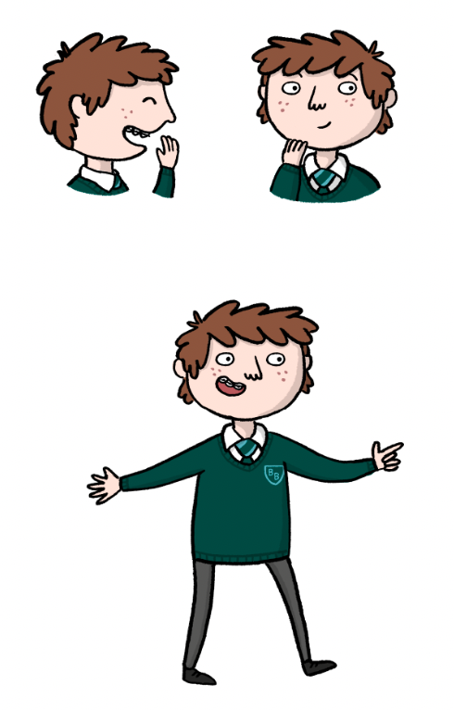
Learning About Neurodiversity at School
Directly addressing the environment created by other people
Teaching about neurodiversity as a whole class
Distinctive from separation + support model
Open participatory design process
Learning objectives & activities
Comprehensive resource for primary schools
Evaluation
In eight classrooms, four schools: feasibility and outcome
Strong focus on risk of harms
Published; free to download
LEANS Champions
Parent pack
Alyssa Alcorn
#LEANSproject
© Claire Hubbard 2021

Slide 23
Learning About Neurodiversity at School
A neurodiversity-affirmative classroom
expects heterogeneity
respects and makes use of pupil expertise
fights stigma
rejects normalisation
accessed by whole classes
no filtering or selection
Alyssa Alcorn
#LEANSproject
Participatory design
Stories showcase respectful practice
teaches about neurodiversity, rather than teaching ND pupils
Directly addresses knowledge, attitudes and actions

Slide 24
Take Home Messages
sue.fletcher-watson@ed.ac.uk
@SueReviews
New ways of understanding neurodivergence
Core deficit models rest on dual unfounded assumptions
We are not delivering on the goals of inclusion
ND kids are literally excluded: from school, socially, and even while learning
Practitioners need new ways of working that maximise wellbeing and participation
Defining neurodiversity and the neurodiversity paradigm
Neurodiversity includes everyone – your classroom, your colleagues and your community
Neurodiversity is naturally occurring, and collectively valuable
Neurodiversity operates much like other dimensions of diversity
What would neurodiversity-affirmative services look like?
How can we create them?
Collaborative, co-produced research-evaluated resources
Joining forces to campaign for systemic change
A neurodiversity-affirmative classroom
expects heterogeneity
respects and makes use of pupil expertise
fights stigma
rejects normalisation

Slide 25
Salvesen Mindroom Research Centre
Policy briefings, book reviews, research opportunities, PsychologiCall
https://www.ed.ac.uk/salvesen-research
My new blog site
Rants and new ideas
https://medium.com/@suefletcherwatson
It Takes All Kinds of Minds
Educators, ND people of all ages, inclusive learning sessions, parent & carer perspectives, policy
https://itakom.org/
Twitter: @suereviews and @SMRCResearch
Mastodon @suereviews
Astle, D. E., Holmes, J., Kievit, R., & Gathercole, S. E. (2021). Annual Research Review: The transdiagnostic revolution in neurodevelopmental disorders. Journal of Child Psychology and Psychiatry.
Chapman, R., & Carel, H. (2022). Neurodiversity, epistemic injustice, and the good human life. Journal of Social Philosophy.
Crompton, C. J., Ropar, D., Evans-Williams, C. V., Flynn, E. G., & Fletcher-Watson, S. (2020). Autistic peer-to-peer information transfer is highly effective. Autism, 24(7), 1704-1712.
Fletcher-Watson, S., Brook, K., Hallett, S., Murray, F., & Crompton, C. J. (2021). Inclusive practices for neurodevelopmental research. Current Developmental Disorders Reports, 8(2), 88-97
Walker, N. (2021). Neuroqueer Heresies: Notes on the neurodiversity paradigm, Autistic empowerment, and postnormal possibilities. Autonomous Press.

